Slide 1
Lifeline:
A Data Science Solution for Medicine
Aiden Cohen, Geoffrey Xue, Matthew Zapodeanu, Elena Zhou

Slide 2
40,000 to 80,000 deaths
33% due to cancer
20% due to vascular issues
due to misdiagnosis per year
Notes:
According to researchers from Johns Hopkins,

Slide 3
How Data Science can Help
Decades of unutilized data for healthcare have been collected
Neural Networks and Decision Trees can accurately predict risk from diseases
No accessible solutions currently exist for warning patients about their risk for disease

Slide 4
Model Design
How the app actually predicts diseases

Slide 5
Dataset Overview
train_set: 50% Train size (597, 11)
validation_set: 20% Valid size (257, 11)
test_set: 30% Test size (367, 11)

Slide 6
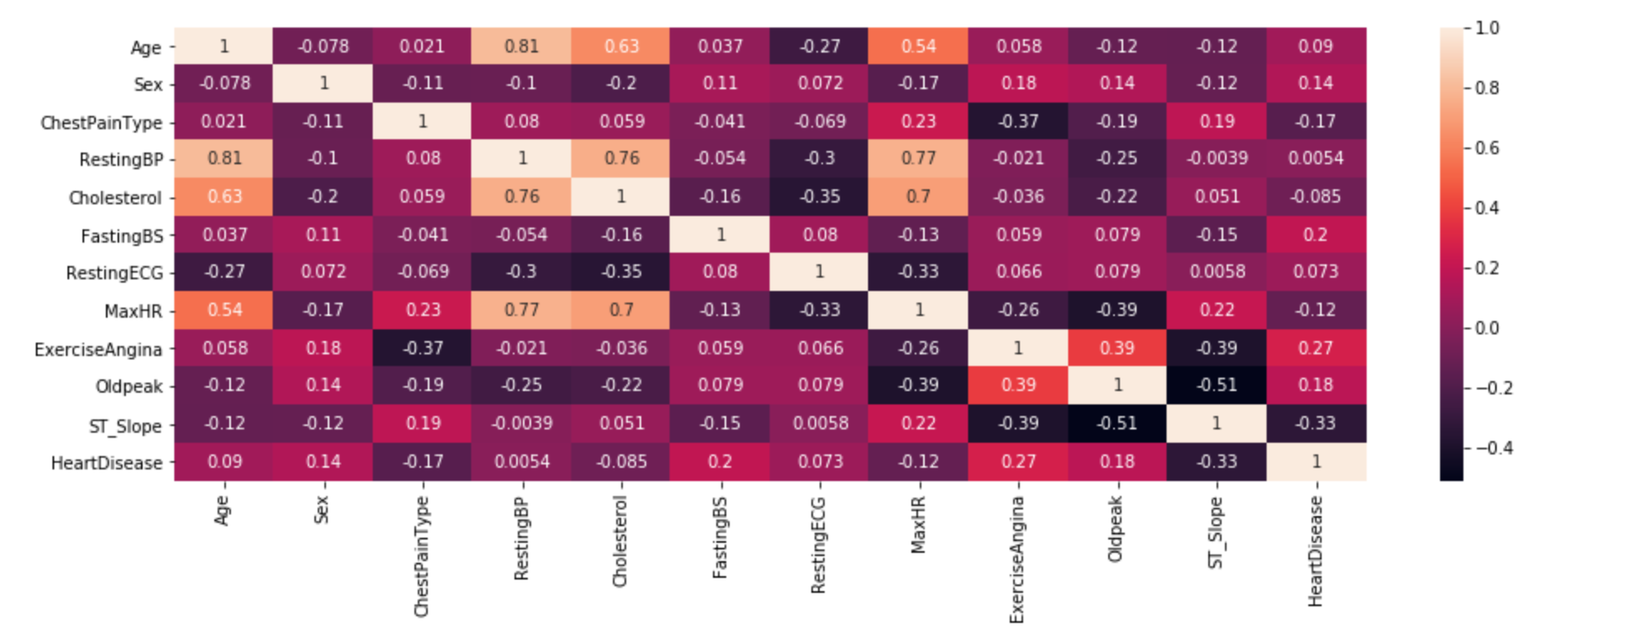
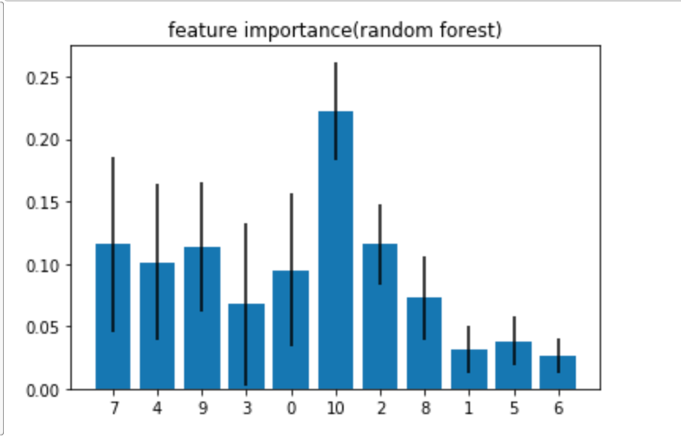
Feature Importance
0:'Age' 1:'Sex' 2:'ChestPainType' 3:'RestingBP' 4:'Cholesterol' 5:'FastingBS' 6:'RestingECG' 7:'MaxHR' 8:'ExerciseAngina' 9:'Oldpeak' 10:'ST_Slope'
Notes:
We used a heat map and random forest classifier to order the features according to their influence to the prediction result. We found that the top essential features are ST_slope, sex, oldpeak, MaxHR, and cholesterol.

Slide 7
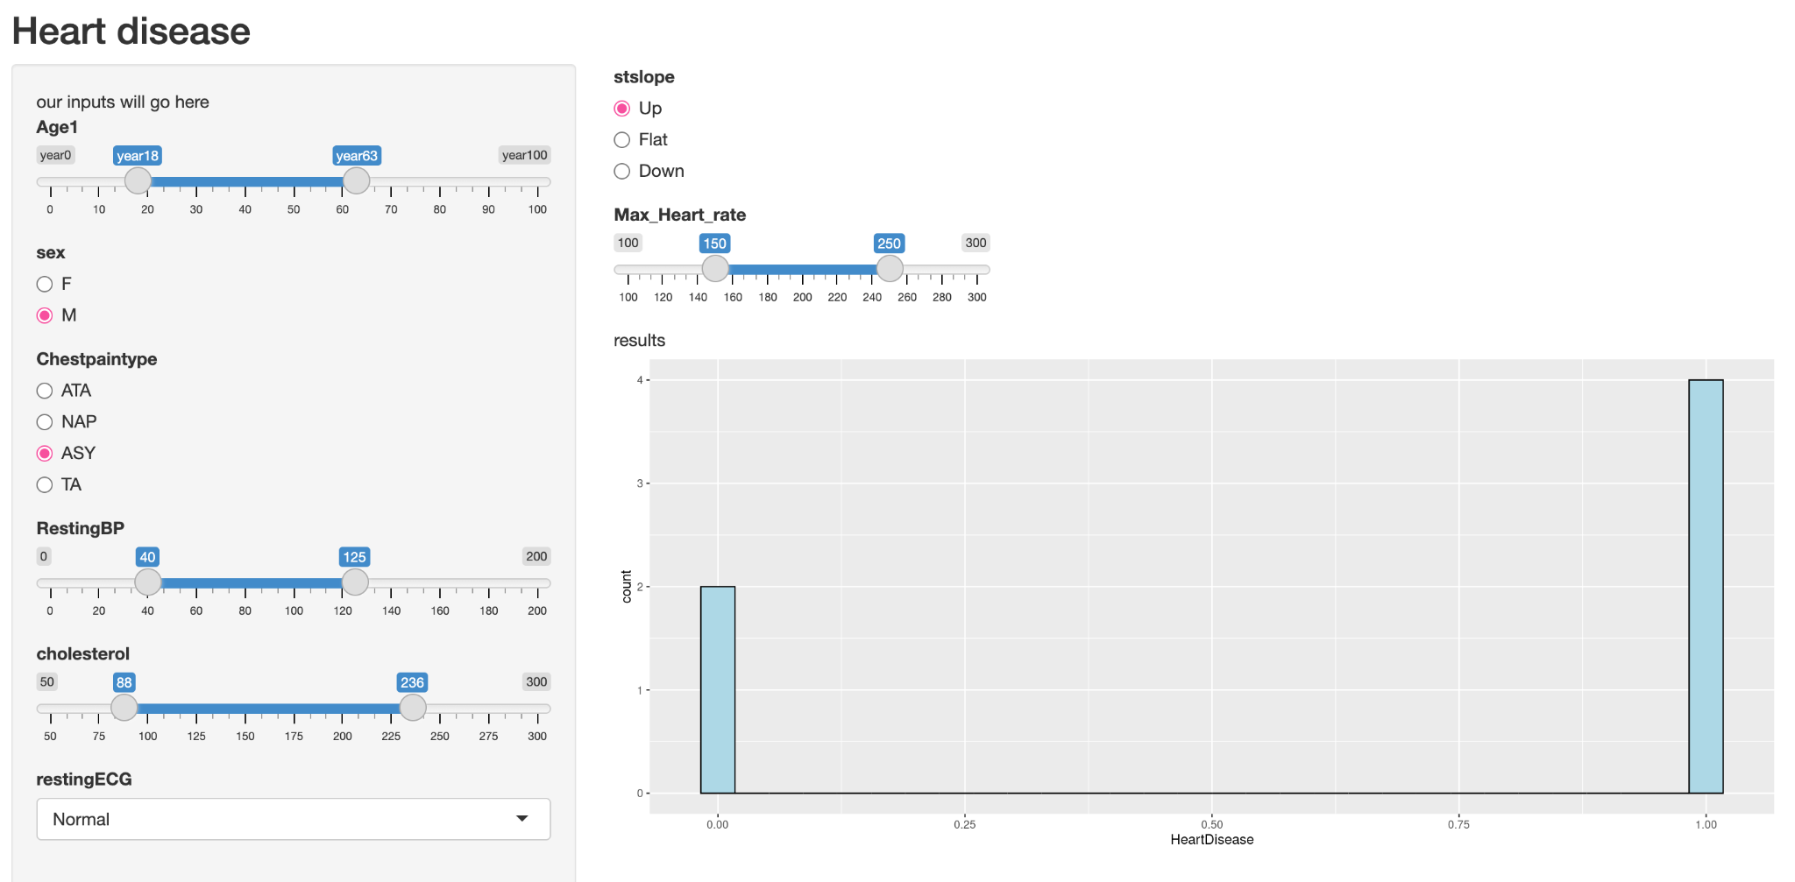
Interactive plot
Notes:
Then we create an interactive plot through the shiny app based on the feature importance plots to present the impact of each essential feature more explicitly.

Slide 8
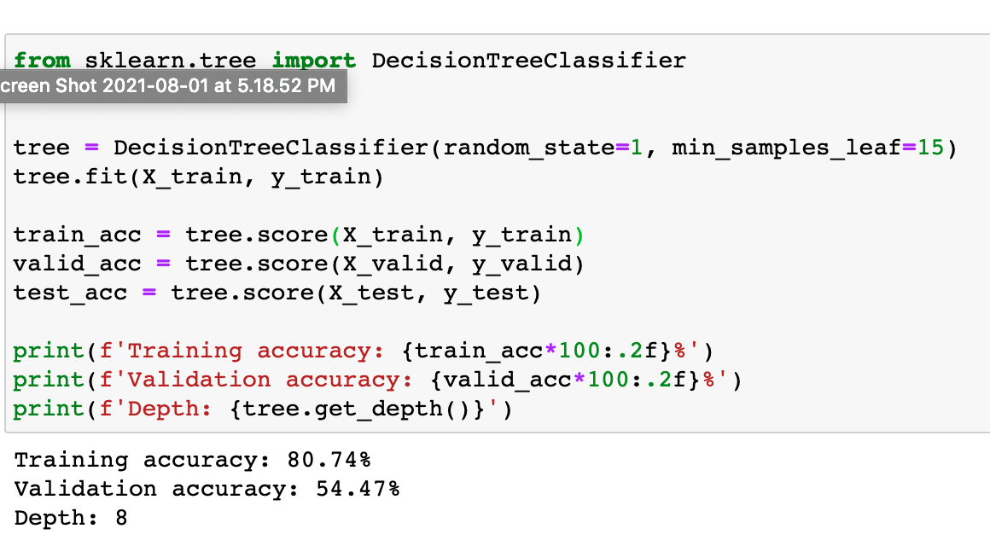
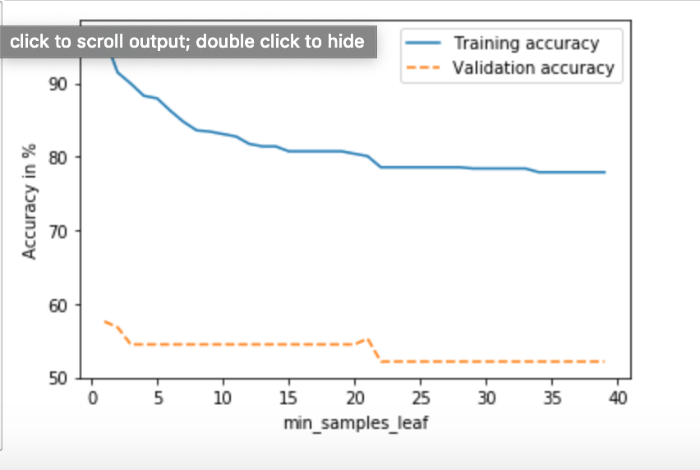
Heart Disease Prediction
Decision Tree
Notes:
We combined two datasets together to make the training dataset larger and to increase the accuracy of prediction. The first model we implemented was decision tree, however, there is a huge gap between the accuracy of the prediction of training dataset and that of validation dataset, the problem of overfitting might exist.

Slide 9
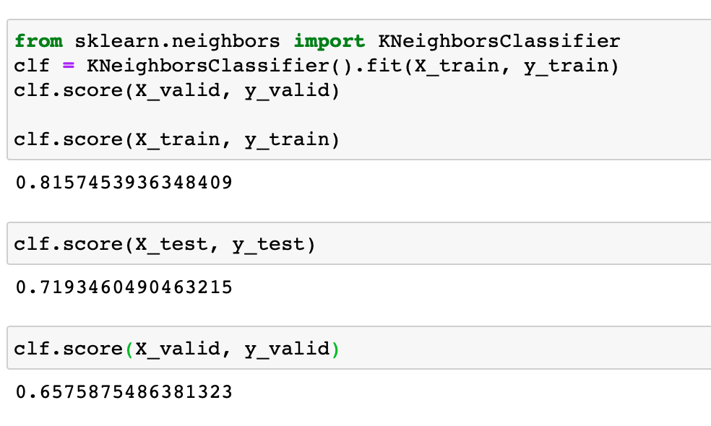
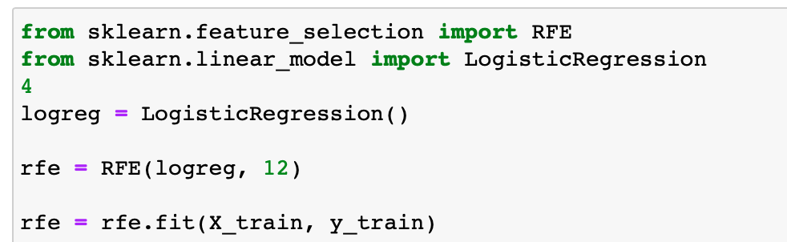
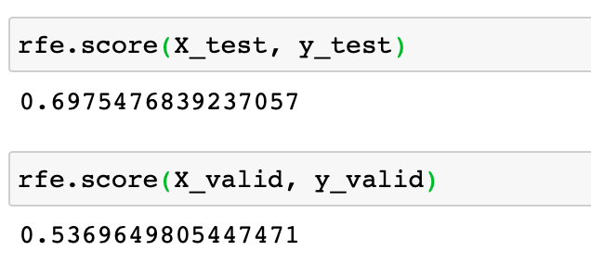
KNN & Logistic Regression model
Notes:
We also implemented the K nearest neighbors model and the logistic regression model and their validation accuracy rates were also unsatisfying.

Slide 10
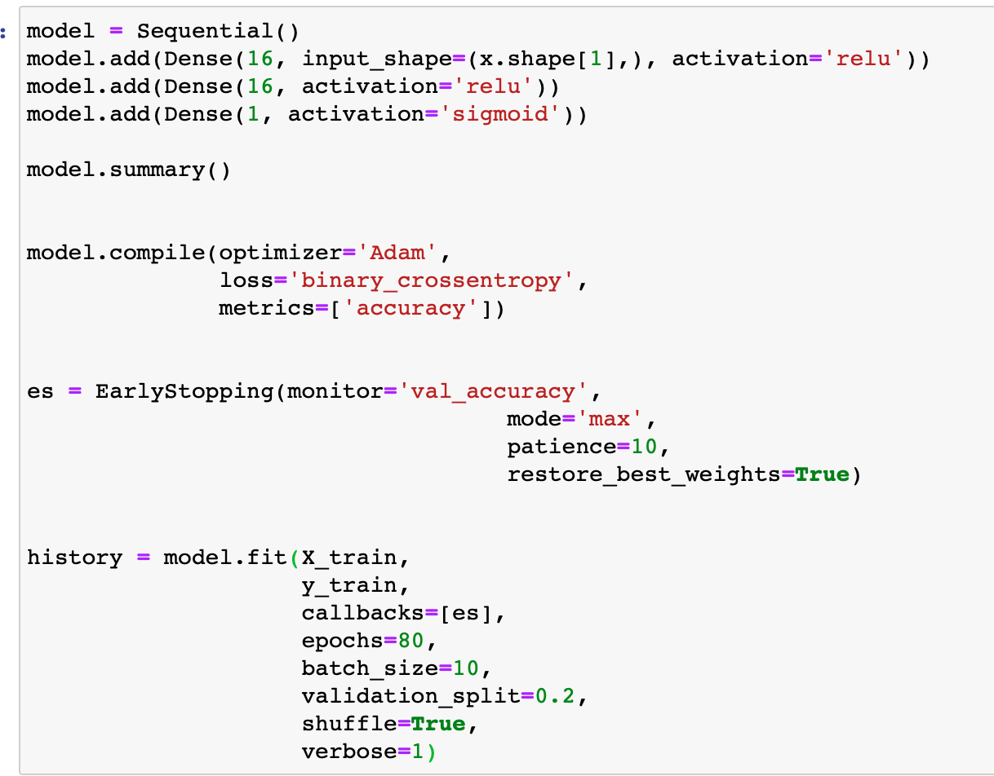
Neural Network
Notes:
We finally applied the neural network model and output high accuracy rates on all the three sub datasets -- training set, validation set, and testing set.

Slide 11
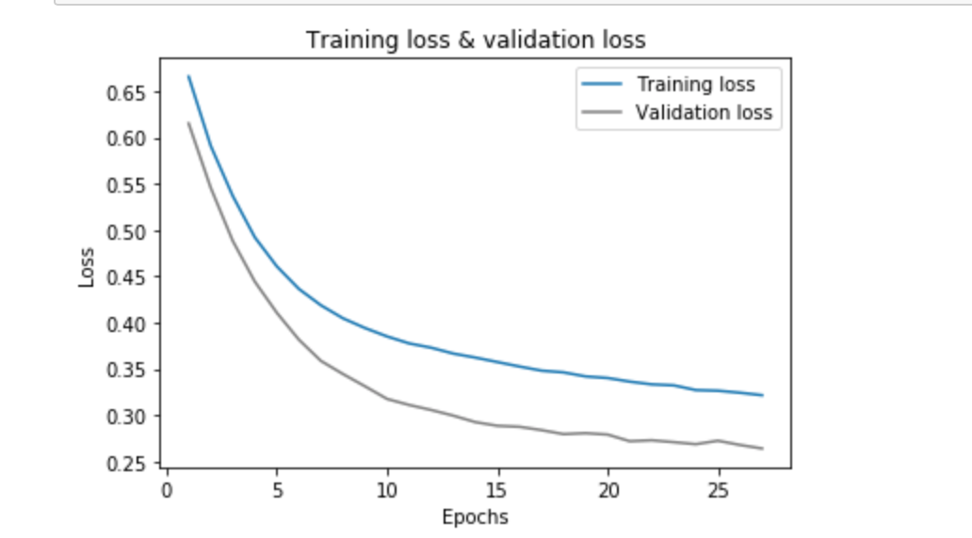
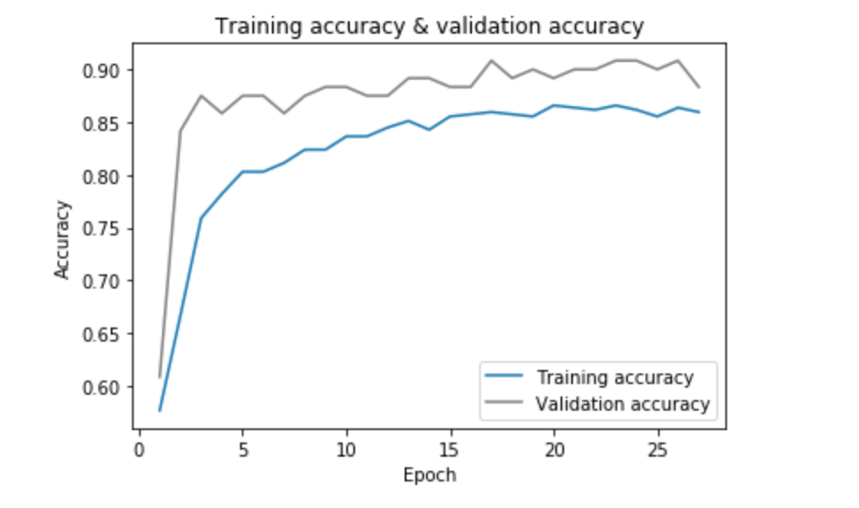
Loss & Prediction Accuracy
Notes:
Based on the loss and accuracy plots, we found that when Epoch is equal to 14, the loss is at the lowest point, and the accuracy rate is at the highest point.

Slide 12
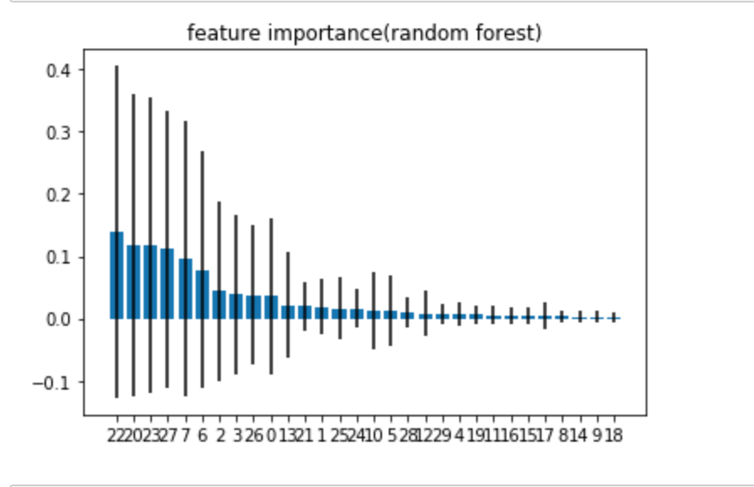
Breast Cancer Tumor Prediction
Notes:
We can see from the feature importance plot that the top influential parameters are : 'symmetry_se'
‘'radius_worst'
'texture_worst'
'compactness_worst'

Slide 13
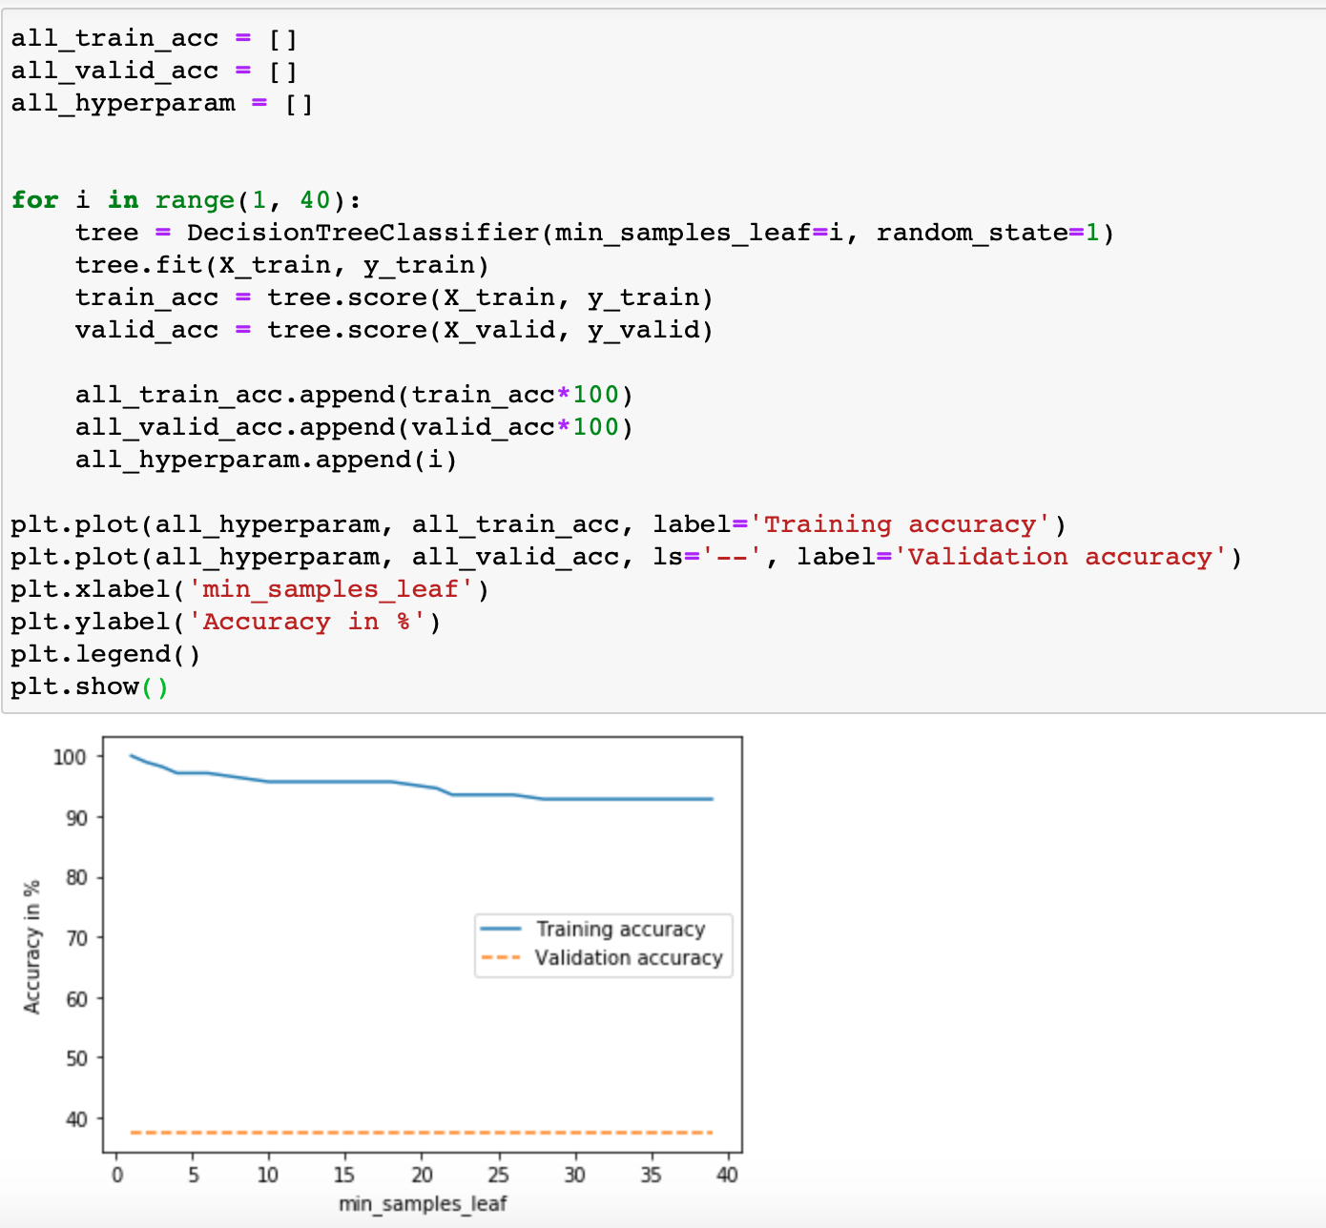
Decision Tree

Slide 14
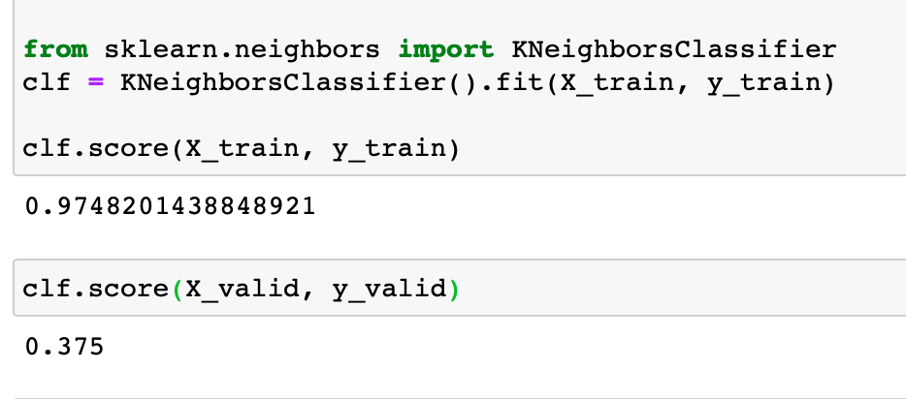
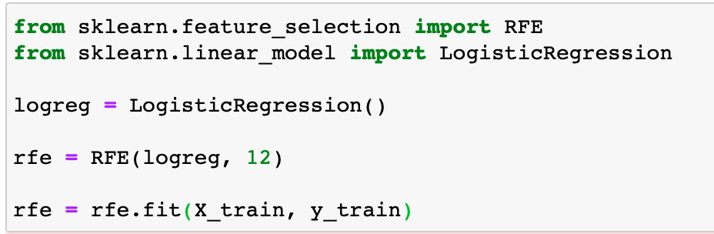
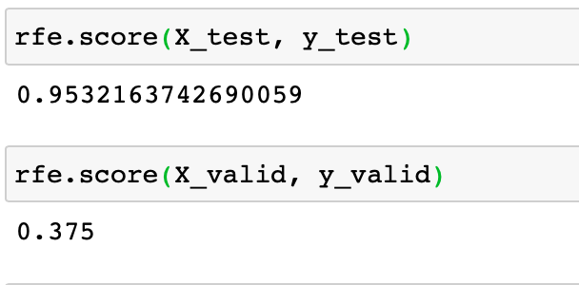
KNN & Logistic Regression Models

Slide 15
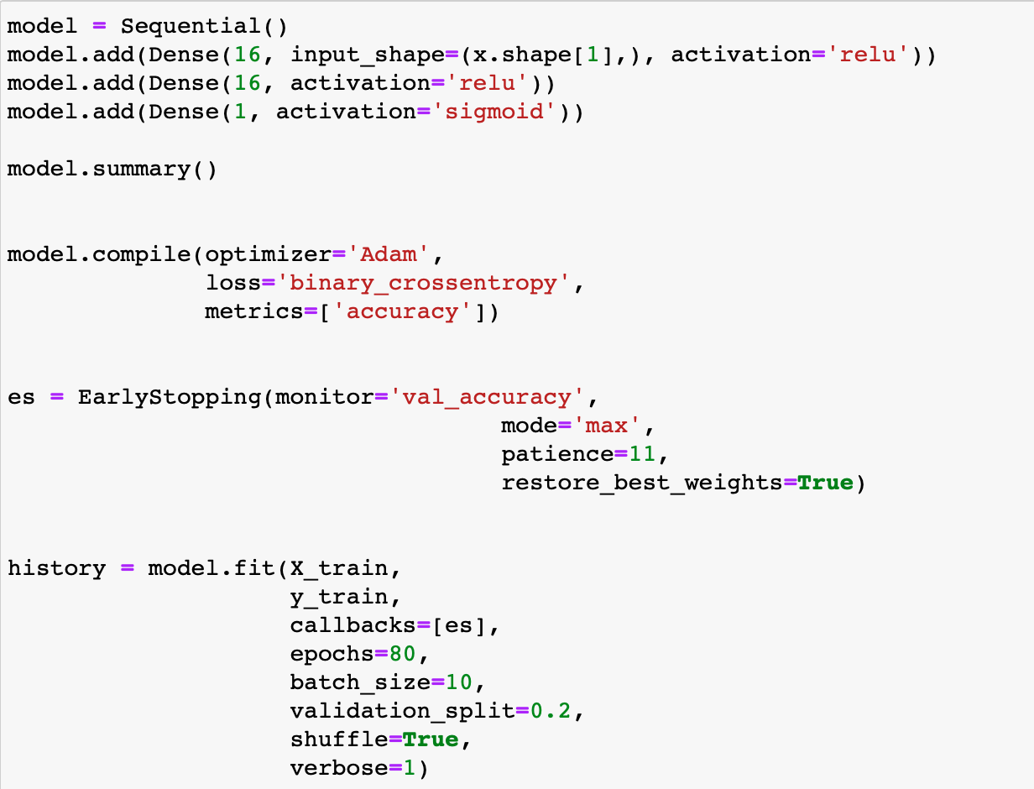
Breast Cancer Neural Network

Slide 16
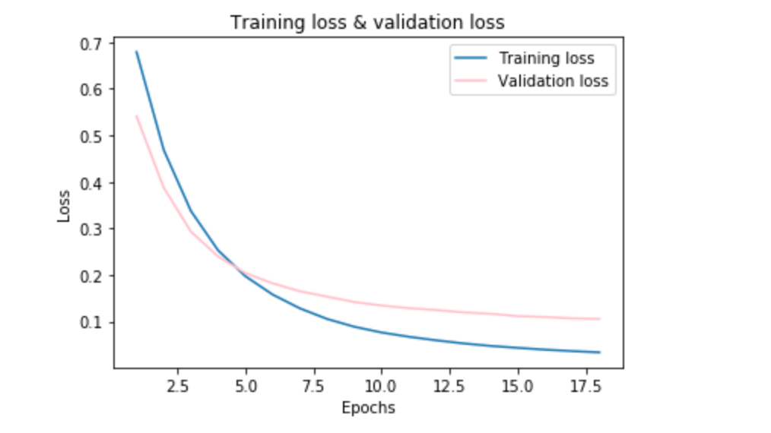
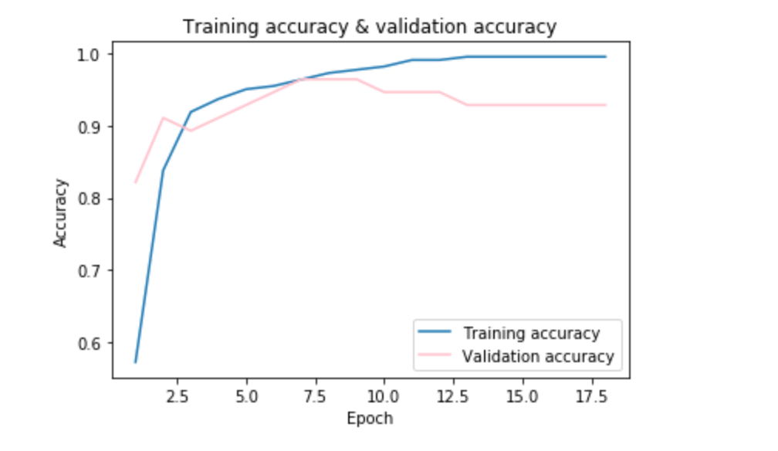
Loss & Prediction Accuracy
Notes:
Based on the loss and accuracy plots, we found that when Epoch is equal to 17.5, the loss is at the lowest point, and the accuracy rate is at a very high point.

Slide 17
UI/UX Design
How the app is accessible to users

Slide 18
Demo

Slide 19


Slide 20
Thanks!
Any questions?

